Slide 1

CSS

Slide 2
“Every line of CSS you write is a suggestion. You are not dictating how the HTML should be rendered; you are suggesting how the HTML should be rendered.”
Jeremy Keith
https://adactio.com/journal/7653

Slide 3
CSS RULES
p.introduction {
line-height: 1.5;
text-align: center;
margin-bottom: 1rem;
}
selector
declaration
value
property

Slide 4
Browser's default
User's styles
Author's styles
CASCADING PRINCIPLES

Slide 5
INHERITANCE
<h1>
The headline
<em>is</em> important!
</h1>

Slide 6
SELECTORS
Selectors allow us to target a specific HTML element to apply rules to it in a CSS declaration.
http://www.w3.org/TR/selectors/

Slide 7
SELECTORS
Type Selectors
ID Selectors
Class Selectors
Contextual Selectors
Attribute Selectors
Pseudo-classes Selectors
Pseudo-elements Selectors
Adjacent Selectors

Slide 8
TYPE SELECTORS
p {
font-size: 0.9em
}

Slide 9
ID SELECTORS
#main {
border: 1px solid; }

Slide 10
CLASS SELECTORS
.alert {
color: #C00;
}

Slide 11
CONTEXTUAL SELECTORS
p span{
font-size: 90%;
}

Slide 12
ATTRIBUTE SELECTORS
input[type=submit] {
color: #FFF;
background: #C00;
}

Slide 13
PSEUDO-CLASSES SELECTORS
a:hover {
text-decoration: none;
}

Slide 14
STRUCTURAL PSEUDO-CLASSES
li:last-child {
border: none;
}

Slide 15
PSEUDO-ELEMENTS SELECTORS
p::before {
content: ‘>’;
}

Slide 16
CHILD & ADJACENT SELECTORS
/* Descendents */
#main h2 {…}
#main > h2 {…}
/* Siblings */
h2 ~ h3 {…}
h2 + h3 {…}

Slide 17
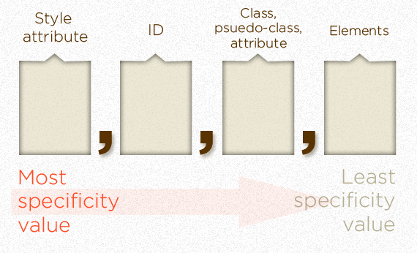
SELECTOR SPECIFICITY

Slide 18
SELECTOR SPECIFICITY
- Equal specificity: the latest rule is the one that counts.
- Unequal specificity: the more specific rule is the one that counts.

Slide 19
PROPERTIES AND VALUES
Font &Text Styles
Color & Shape
Display & Dimensions
Positioning and Layout

Slide 20
SELECTORS
Hands-on

Slide 21
FONT & TEXT STYLES
My text
p.mytext {
font-family:
Arial, sans-serif;
font-size: 2em;
font-weight: bold;
}

Slide 22
FONT & TEXT STYLES
M Y T E X T
p.mytext {
…
text-align: center;
letter-spacing: 0.3em;
text-transform: uppercase;
}

Slide 23
COLOR & SHAPE
M Y T E X T
p.mytext {
…
color: #00CC33;
background: #FFFFF;
border-weight: 5px;
border-type: solid;
border-color: #FF0000;
}

Slide 24
COLOR & SHAPE
M Y T E X T
p.mytext {
…
color: #0C3;
background: #FFF;
border: 5px solid #F00;
}

Slide 25

COLOR & SHAPE
M Y T E X T
p.mytext {
…
background-image:
url(myimage.jpg);
background-position: 0 0;
background-repeat: no-repeat;
}

Slide 26
BASICS
Hands-on

Slide 27
DISPLAY & DIMENSIONS
When your browser displays an element, the element takes up space. You can think of all HTML elements as boxes. All boxes have certain dimensions and are specified by four properties: a content area of the element (e.g., a picture, a text header, etc.) and the optional padding, border and margin properties.
http://docs.webplatform.org/wiki/tutorials/box_model

Slide 28
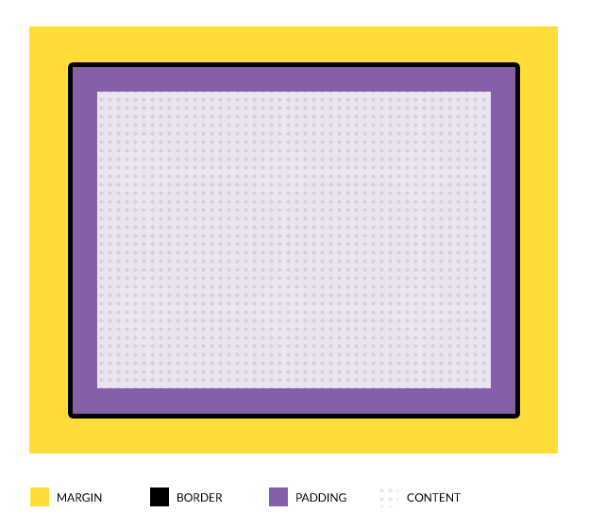
DISPLAY & DIMENSIONS: The Box Model

Slide 29
DISPLAY & DIMENSIONS: The Box Model
div.mybox {
width: 500px;
height: 200px;
padding: 20px;
margin: 10px 5px 10px 5px;
border: 5px solid #FFF;
}

Slide 30
DISPLAY DIMENSIONS: The Box Model
div.mybox {
box-sizing: border-box;
// or padding-box
width: 500px;
height: 200px;
padding: 20px;
margin: 10px 5px 10px 5px;
border: 5px solid #FFF;
}

Slide 31
DISPLAY & DIMENSIONS
Block Elements
A block-level element occupies the entire space of its parent element.
Browsers typically display the block-level element with a new line both before and after the element.
div, section, article, aside, footer, header, h1, h2…, p, etc.

Slide 32
DISPLAY & DIMENSIONS
Inline Elements
An inline-level element has no dimensions (no width/height)
Browsers typically display the inline-level elements one beside the other.
a, span, strong, em, input, etc.

Slide 33
DISPLAY & DIMENSIONS
Home
Next
<p>
<a href=“index.html”>Home</a>
<a href=“next.html”>Next</a>
</p>
a {
display: inline-block;
}

Slide 34
DISPLAY & DIMENSIONS
Home
Next
a {
display: block;
}

Slide 35
POSITIONING AND LAYOUT
Position
Float
Flex
Grid, …

Slide 36
POSITION PROPERTY
Absolute
<div class=“child”></div>
. child{
position: absolute;
width: 55%;
top: 0;
left:0;
}

Slide 37
POSITION PROPERTY
Absolute
<div class=“father”>
<div class=“child”></div>
</div>
.father { margin: 20px; }
.child{
position: absolute;
width: 55%;
top: 0;
left:0;
}

Slide 38
POSITION PROPERTY
Absolute
<div class=“father”>
<div class=“child”></div>
</div>
.father {
position: relative;
margin: 20px;
}
.child{
position: absolute;
width: 55%;
top: 0;
left:0;
}

Slide 39
POSITION PROPERTY
Relative
<div class=“father”>
<div class=“child”></div>
</div>
.father {
position: relative;
margin: 20px;
top: 20px
left: 20px;
}
.child{
position: absolute;
width: 55%;
bottom: 5px;
right: 5px;
}

Slide 40
FLOAT POSITIONING
<div></div>
<div></div>
<div></div>
<div></div>
1
2
3
4

Slide 41
FLOAT POSITIONING
<div></div>
<div></div>
<div></div>
<div></div>
1
2
3
4
div {
float: left;
width: 30%;
margin: 1% 1% 0;
}

Slide 42
FLOAT POSITIONING
<div></div>
<div></div>
<div></div>
<div></div>
3
2
1
4
div {
float: right;
width: 30%;
margin: 1% 1% 0;
}

Slide 43
FLOAT POSITIONING
<div class=“father”>
<div></div>
<div></div>
<div></div>
<div></div>
</div>
1
2
3
4
.father {
background-color: #CCC;
}
.father div {
float: left;
width: 30%;
margin: 1% 1% 0;
}

Slide 44
FLOAT POSITIONING
<div class=“father”>
<div></div>
<div></div>
<div></div>
<div></div>
</div>
1
2
3
4
.father {
float: left;
width: 100%;
background-color: #CCC;
}
.father div {
float: left;
width: 30%;
margin: 1% 1% 0;
}

Slide 45
POSITIONING
Hands-on

Slide 46
FLEX POSITIONING
The flex CSS property is a shorthand property specifying the ability of a flex item to alter its dimensions to fill available space. Flex items can be stretched to use available space proportional to their flex grow factor or their flex shrink factor to prevent overflow.

Slide 47
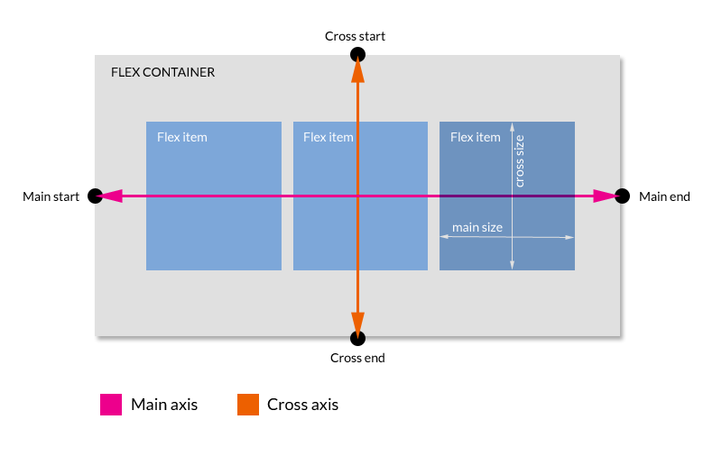
FLEX POSITIONING

Slide 48
FLEX POSITIONING
First, tell the container its kids are « flex »:
<div class=“father”>
<div></div>
<div></div>
<div></div>
<div></div>
</div>
div.father {
display: flex;
display: -webkit-flex;
}

Slide 49
FLEX POSITIONING
Then, determine how the kids will behave:
<div class=“father”>
<div></div>
<div></div>
<div></div>
<div></div>
</div>
div.father div {
flex: 1 0 auto;
-webkit-flex: 1 0 auto;
}

Slide 50
FLEX POSITIONING
Flow of content: flow-direction
div.father {
display: flex;
display: -webkit-flex;
flex-direction: row;
-webkit-flex-direction: row;
}
1
2
3
4
5

Slide 51
FLEX POSITIONING
Flow of content: flow-wrap
div.father {
display: flex;
display: -webkit-flex;
flex-wrap: wrap;
-webkit-flex-wrap: wrap;
}
1
2
3
4
5

Slide 52
FLEX POSITIONING
Flow of content: A Shorthand
flexcontainer {
flex-flow: <flex-direction> || <flex-wrap>;
}
div.father {
display: flex;
display: -webkit-flex;
flex-flow: row wrap;
-webkit-flex-flow: row wrap;
}
1
2
3
4
5

Slide 53
FLEX POSITIONING
Alignment of content (main-axis):
justify-content
div.father {
display: flex;
display: -webkit-flex;
flex-flow: row wrap;
-webkit-flex-flow: row wrap;
justify-content: center;
-webkit-justify-content: center;
}
1
2
3
4
5

Slide 54
FLEX POSITIONING
Alignment of content (cross-axis):
align-content
div.father {
display: flex;
display: -webkit-flex;
flex-flow: row wrap;
-webkit-flex-flow: row wrap;
align-content: center;
-webkit-align-content: center;
}
1
2
3
4
5
My kids are displayed in multiple lines!

Slide 55
FLEX POSITIONING
Alignment of content (perpendicular):
align-items
div.father {
display: flex;
display: -webkit-flex;
flex-flow: row wrap;
-webkit-flex-flow: row wrap;
align-items: center;
-webkit-align-items: center;
}
1
2
3
4
5

Slide 56
FLEX POSITIONING
Flex item behavior: flex-basis
div.father {
display: flex;
display: -webkit-flex;
flex-flow: row wrap;
-webkit-flex-flow: row wrap;
}
div.father div {
flex-basis: 35%;
-webkit-flex-basis: 35%;
}
1
2
3
4
5

Slide 57
FLEX POSITIONING
Flex item behavior: flex-grow
div.father {
display: flex;
display: -webkit-flex;
}
div.father div {
flex-basis: 5%;
}
div.father div:nth-child(3) {
flex-grow: 3;
}
1
2
3
4
5

Slide 58
FLEX POSITIONING
Flex item behavior: flex-shrink
div.father {
display: flex;
display: -webkit-flex;
}
div.father div {
flex-basis: 5%;
}
div.father div:nth-child(3) {
flex-shrink: 0;
}
1
2
3
4
5

Slide 59
FLEX POSITIONING
Flex item behavior: A Shorthand
flexitem {
flex: <flex-grow> || <flex-shrink> || <flex-basis>;
}
div.father {
display: flex;
display: -webkit-flex;
flex-flow: row wrap;
-webkit-flex-flow: row wrap;
}
div.father div {
flex: 1 1 auto;
}
1
2
3
4
5

Slide 60
FLEX POSITIONING
Flex item order: order
div.father {
display: flex;
display: -webkit-flex;
flex-flow: row wrap;
-webkit-flex-flow: row wrap;
}
div.father div:nth-child(3) {
flex: 1 1 auto;
order: -1;
}
3
1
2
4

Slide 61
FLEX POSITIONING
Hands-on

Slide 62
MEDIA QUERIES
Syntax
Types
Features
Tools

Slide 63
MEDIA QUERIES
The @media CSS at-rule associates a set of nested statements, in a CSS block that is delimited by curly braces, with a condition defined by a media query. The @media at-rule may be used not only at the top level of a CSS, but also inside any CSS conditional-group at-rule.
https://developer.mozilla.org/en-US/docs/Web/CSS/@media

Slide 64
MEDIA QUERIES
Syntax
#wrapper { … }
@media <types><features> {
/* media-specific rules */
#wrapper { … }
}

Slide 65
MEDIA QUERIES
Types
All
Print
Screen
Speech

Slide 66
MEDIA QUERIES
Features
min-width
max-width
orientation, resolution, …

Slide 67
MEDIA QUERIES
Syntax
#wrapper { … }
@media screen
and (min-width: 500px ){
/* media-specific rules */
#wrapper { … }
}

Slide 68
MEDIA QUERIES
Syntax
#wrapper { … }
@media screen
and (min-width: 500px)
and (max-width: 800px) {
/* media-specific rules */
#wrapper { … }
}

Slide 69
MEDIA QUERIES
Tools
Ripple
Google Chrome Console
Firefox (Ctrl+Maj+M)

Slide 70
Kawwa
https://kawwa.atosworldline.com/
Web Platform
http://www.webplatform.org/
Mozilla Developer Network
https://developer.mozilla.org/
Flex Box Cheatsheets
http://www.sketchingwithcss.com/samplechapter/cheatsheet.html
http://jonibologna.com/flexbox-cheatsheet/
REFERENCES

